Slide 1

Battle of the neighbourhoods – PRESENTATION
Brittany Easton for IBM – Applied data science capstone

Slide 2
Business problem
The client is a black belt in Brazilian Jiujitsu, and is looking to open up her own martial arts studio in the Toronto. She has asked for a recommendation on where to start her business.
The client asks that the criteria for the recommendation be based on the following priorities:
First and foremost, she is focused on quickly creating a profitable business. Therefore the region she selects should have lower competition to allow for faster growth. The area she selects to start her business needs to have a smaller ratio of studios relative to the number of people so that she can easily compete as a newcomer.
She is interested in starting her business in an area where she can make a big impact and have the greatest opportunity to grow a large membership base. An area with a higher population and a higher density will mean the business is closer and accessible to more people.
Since doing martial arts can be an expensive hobby, she would like to make sure that the region where she sets up her business is an affluent one. A region where more households are making more than $100,000 mean that the people who live there can more easily afford Brazilian Jiujitsu for the whole family.

Slide 3


data
Data Source: | Foursquare | AggData
Data Contents: | Location & Venue data | Coordinates by FSA
What insight does this data provide? | The level of competition in a particular region. | The geographic coordinates of each FSA within the Greater Toronto Area
What data will be used? | The count of, and the location of martial arts studios in the GTA. | FSA, Latitude, Longitude, Province, Place Name
How will the data be used? | In determining population density per studio, and the number of high income households per studio in each region. | Map the Toronto regions
Example Data | Action & Reaction MMA 485 McNicoll Ave, North York M2H 3H9 | L3R: Markham, ON 43.8479 -79.3288

Slide 4



data
Data Source: | Canada Revenue Agency | Statistics Canada | Postal Codes in Canada
Data Contents: | Household Income by FSA | Population by FSA | FSAs by County
What insight does this data provide? | The ability of the households in Toronto to afford a recreational hobby in the martial arts. | How much room for growth exists for the business. | Which FSAs lay within which geographical region.
What data will be used? | The number of households per FSA which make a particular range of income. | Geographic Name, Population (2016), Total Private Dwellings (2016) | FSA, Type (indicates region, city or county name)
How will the data be used? | Proportion of households in each FSA making over $100,000 in income will inform a conversion rate. | Population size and density will inform metrics for growth | To define the geographical region of each FSA.
Example Data | FSA $100,000 to $149,999 A0A 1900 | FSA POP (2016) DWELL (2016) A0A 46,587 26,155 | FSA TYPE K1C OTTAWA

Slide 5
data
Data Source | Data Contents | Data Access Through
Foursquare | Location & venue data | Foursquare API
AggData | Coordinates by FSA | Complete List of Canada Postal Codes (FSAs)
Canada Revenue Agency | Household Income by FSA | Individual Tax Statistics by Forward Sortation Area (FSA) − 2019 Edition (2017 tax year)
Statistics Canada | Population by FSA | Population and Dwelling Count Highlight Tables, 2016 Census
Postal Codes in Canada | FSAs by County | Ontario Postal Codes List

Slide 6
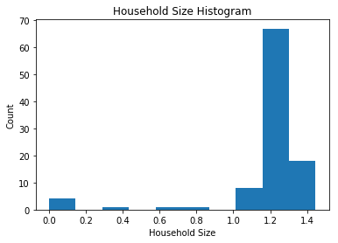
Average Household size in Toronto has an interquartile range between 1.19 & 1.28

Slide 7
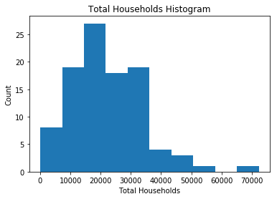
The bulk of fsas IN THE GTA have 35,000 households or fewer

Slide 8
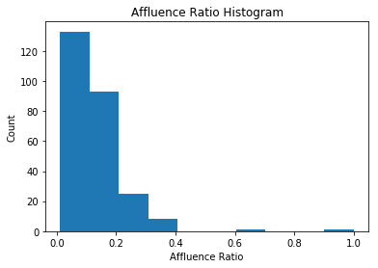
Affluence ratio does not follow a normal distribution and has a Mean of 0.12

Slide 9
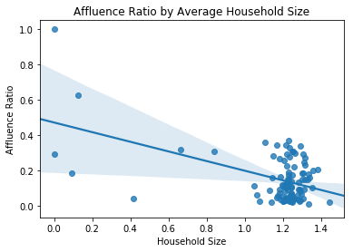
there is a negative correlation between the average household size in an fsa, and its affluence ratio

Slide 10
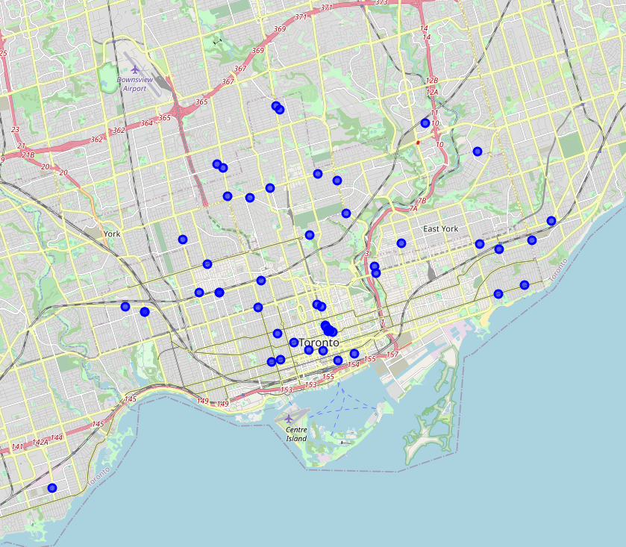
Fewer than 50 martial arts studios exist in Toronto most are concentrated in the downtown & centrally

Slide 11
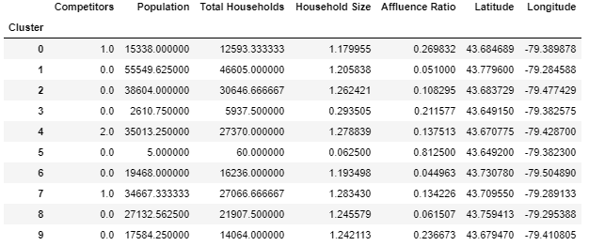
Ten clusters of Toronto fsas reveal highest affluence is associated with lowest average total households

Slide 12
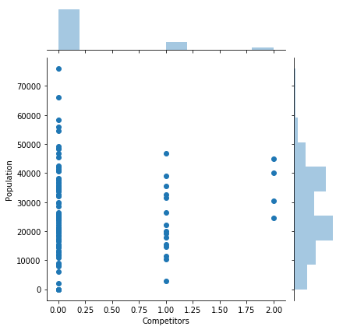
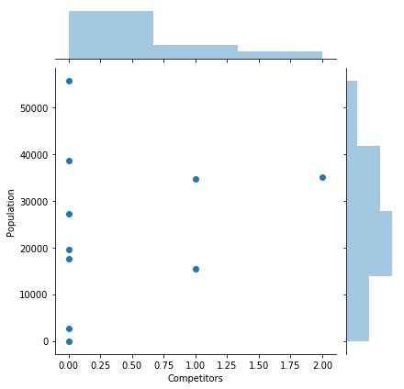
most fsas have no competition
Most clusters have no competition

Slide 13
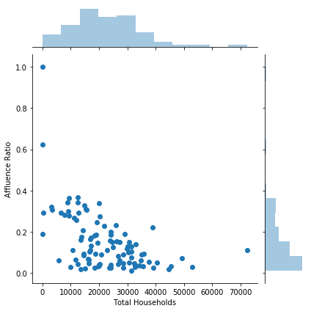
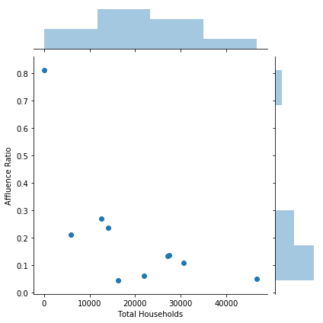
Affluence ratio is negatively correlated to total households per cluster
Affluence ratio is negatively correlated to total households per fsa

Slide 14
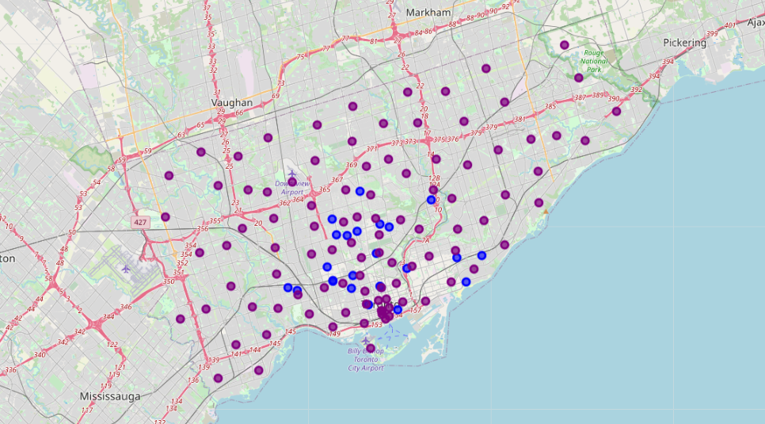
Purple dots show fsas encompassed within toronto

Slide 15
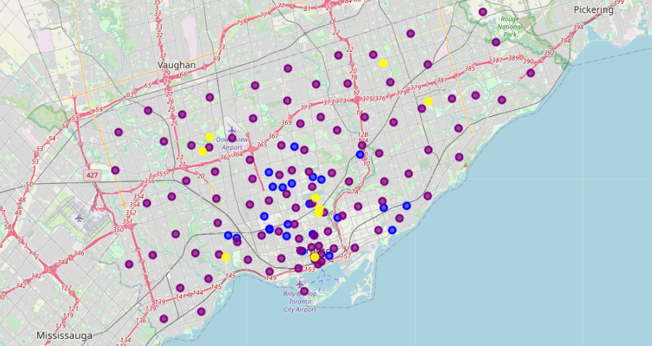
Clusters shown in yellow

Slide 16
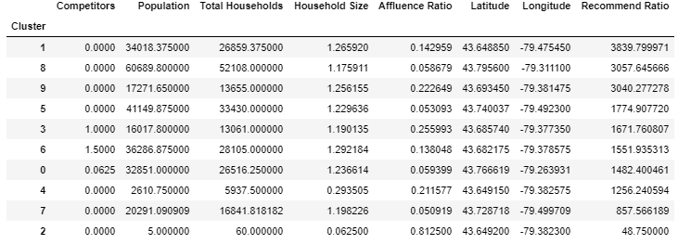
Recommend ratio is calculated as the product of population & affluence Ratio over competitors +1 The larger the recommend ratio, the more opportunity exists in the cluster.

Slide 17
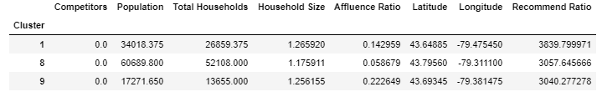
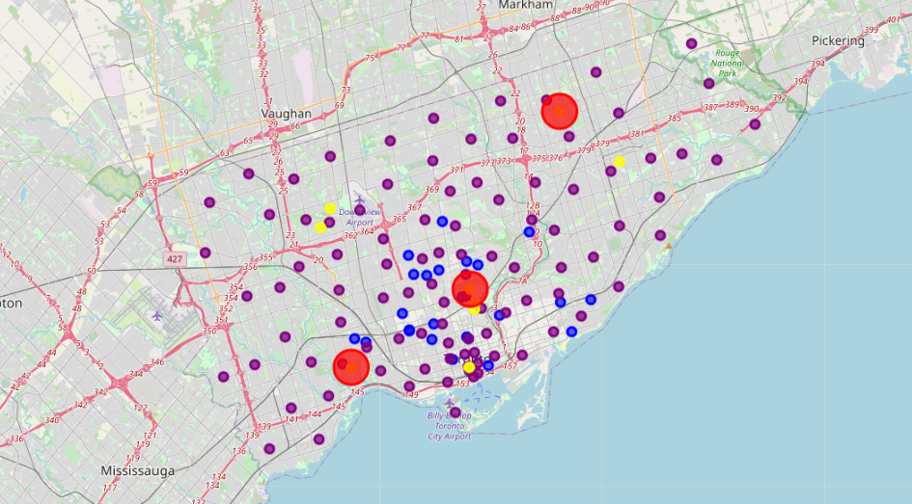
Top 3 recommendations for a new martial arts business: 1. Etobicoke (43.648850, -79.475450) 2. SCARBOROUGH (43.795600, -79.311100) 3. CENTRAL TORONTO (43.693450, -79.381475)

Slide 18
Future directions
Suggestions for future improvements of this analysis include:
- taking more location data features into account
- using membership data for competitive studios to show areas with less penetration, and therefore more opportunity
- using commercial real estate pricing to show areas with higher rental prices
- using a choropleth map to show competition, population, and affluence
- using a clustermap to differentiate relative similarity between clusters
- collecting publicly available revenue data for competitive studios for predictive modeling.¶

